Slide 1
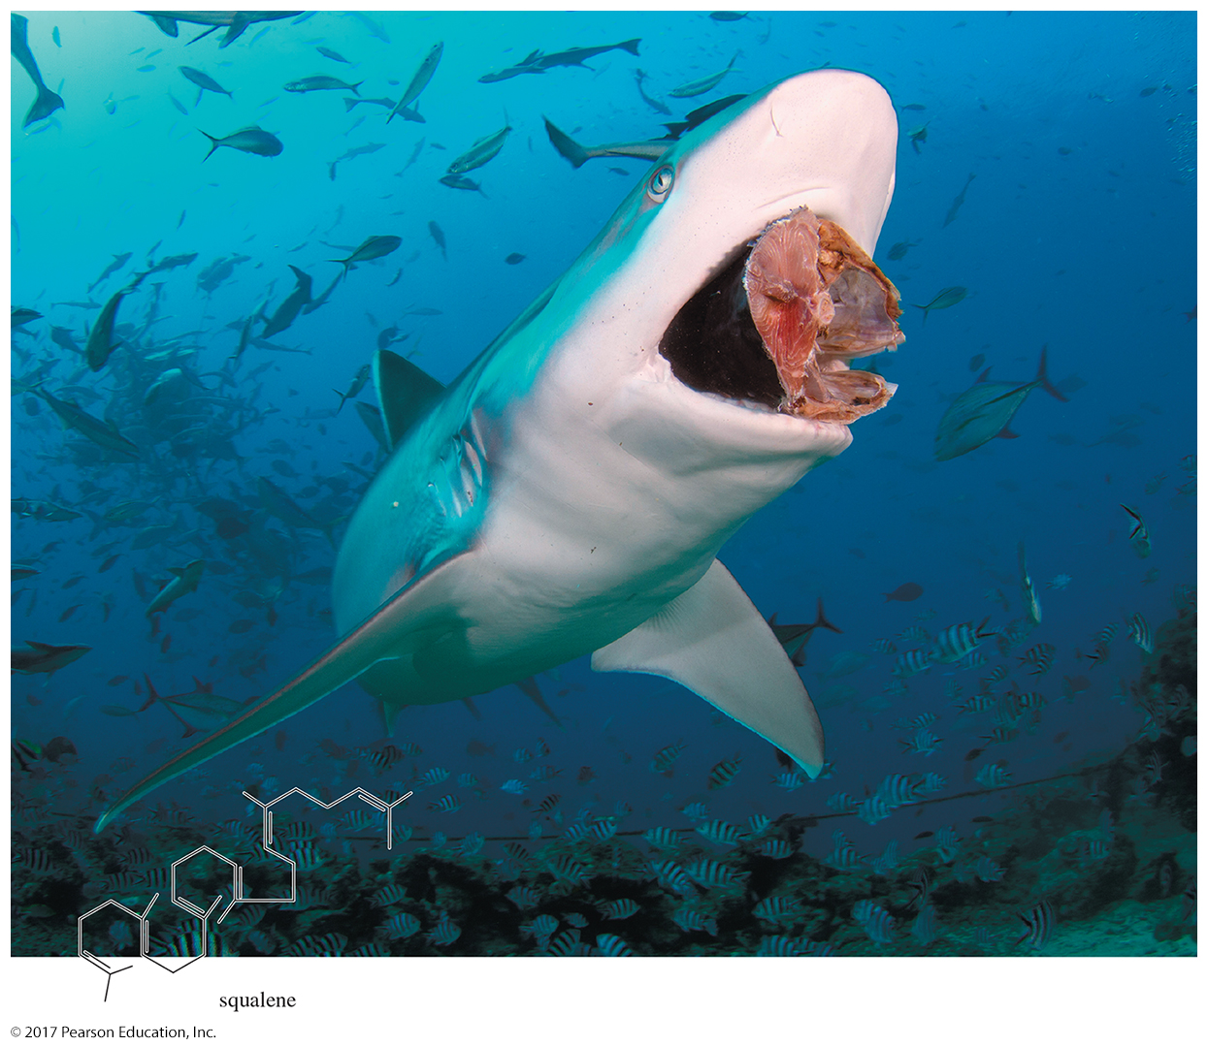
Organic Chemistry, 9th Edition L. G. Wade, Jr.
Chapter 7 Lecture
Structure and Synthesis
of Alkenes
Chad Snyder, PhD
Grace College
© 2017 Pearson Education, Inc.

Slide 2
Introduction
Alkenes are hydrocarbons with carbon–carbon double bonds.
Alkenes are also called olefins, meaning “oil-forming gas.”
The functional group of alkenes is the carbon–carbon double bond, which gives this group its reactivity.

Slide 3
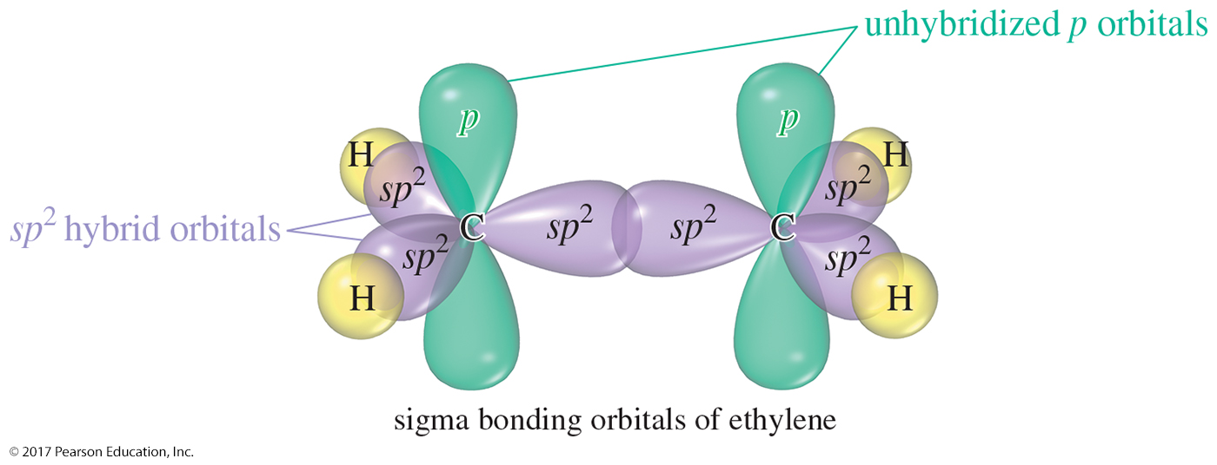
Sigma Bonds of Ethylene

Slide 4
Orbital Description
Sigma bonds around the double-bonded carbon are sp² hybridized.
Angles are approximately 120° and the molecular geometry is trigonal planar.
Unhybridized p orbitals with one electron will overlap, forming the double bond (pi bond).

Slide 5
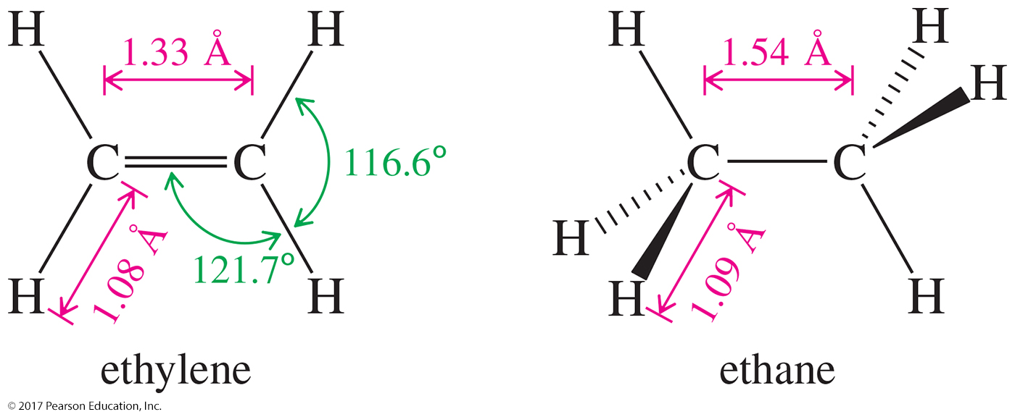
Bond Lengths and Angles
sp² hybrid orbitals have more s character than the sp³ hybrid orbitals.
Pi overlap brings carbon atoms closer, shortening the C—C bond from 1.54 Å in alkanes down to 1.33 Å in alkenes.

Slide 6
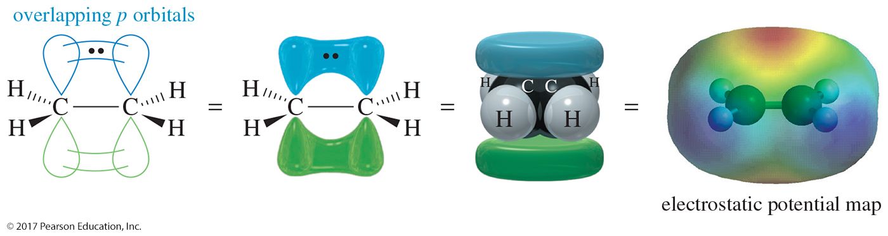
Pi Bonding in Ethylene
The pi bond in ethylene is formed by overlap of the unhybridized p orbitals of the sp² hybrid carbon atoms.
Each carbon has one unpaired electron in the p orbital.
This overlap requires the two ends of the molecule to be coplanar.

Slide 7
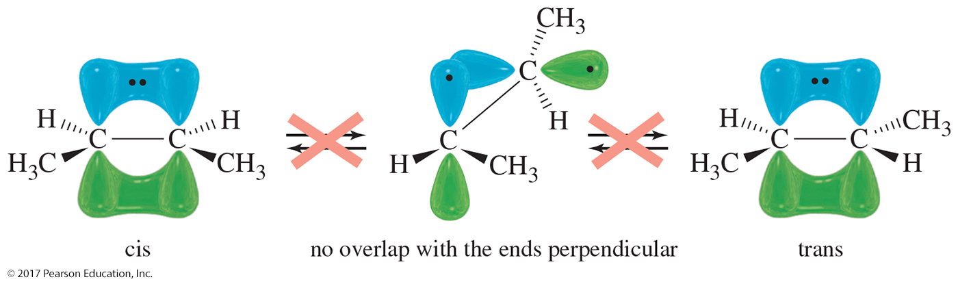
Cis-Trans Interconversion
Cis and trans isomers cannot be interconverted.
No rotation around the carbon–carbon bond is possible without breaking the pi bond (264 kJ/mole).

Slide 8
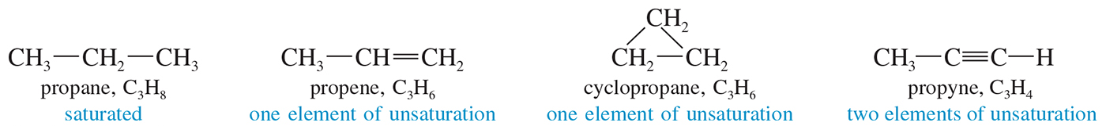
Elements of Unsaturation
Unsaturation is a structural element that decreases the number of hydrogens in the molecule by two.
It is also called index of hydrogen deficiency.
Double bonds and rings are elements of unsaturation.

Slide 9
Calculating Unsaturations
To calculate the number of unsaturations, first find the number of hydrogens the carbons would have if the compounds were saturated. Then subtract the actual number of hydrogens and divide by 2.
This calculation cannot distinguish between unsaturations from multiple bonds and those from rings.

Slide 10
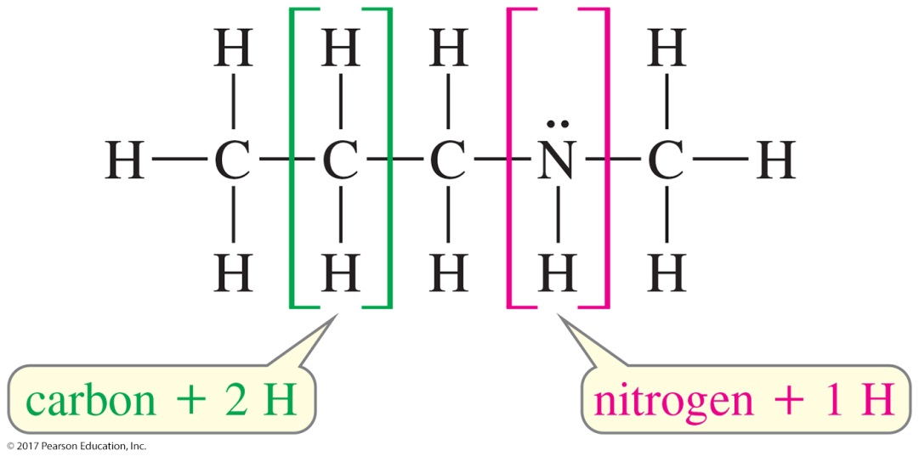
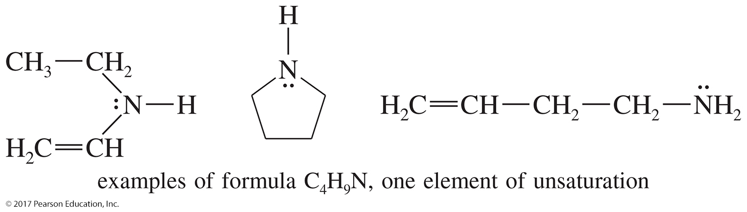
Degrees of Unsaturation: The Nitrogen Atom

Slide 11
Example: Calculate the Unsaturations for a Compound with Formula C₅H₈.
First calculate the number of hydrogen atoms for a saturated compound with five carbons: (2 × C) + 2 (2 × 5) + 2 = 12
Now subtract from this number the actual number of hydrogen atoms in the formula and divide by 2:
12 – 8 = 4 = 2 unsaturations
2 2
The compound has two unsaturations. They can be two double bonds, two rings, or one double bond and one ring.

Slide 12
Elements of Unsaturation: Heteroatoms
Halogens replace hydrogen atoms in hydrocarbons, so when calculating unsaturations, count halides as hydrogen atoms.
Oxygen does not change the C:H ratio, so ignore oxygen in the formula.
Nitrogen is trivalent, so it acts like half a carbon. Add the number of nitrogen atoms when calculating unsaturations.

Slide 13
Example: Calculate the Unsaturations for a Compound with Formula C₄H₇Br.
First calculate the number of hydrogens for a saturated compound with four carbons: (2 × C) + 2 + N (2 × 4) + 2 = 10
Now subtract from this number the actual number of hydrogens in the formula and divide by 2. Remember to count halides as hydrogens:
10 – 8 = 2 = 1 unsaturation
2 2

Slide 14
Example: Calculate the Unsaturations for a Compound with Formula C₆H₇N.
First calculate the number of hydrogens for a saturated compound with six carbons. Add the number of nitrogens: (2 × C) + 2 + N (2 × 6) + 2 + 1 = 15
Now subtract from this number the actual number of hydrogens in the formula and divide by 2:
15 – 7 = 8 = 4 unsaturations
2 2

Slide 15
IUPAC Nomenclature
Find the longest continuous carbon chain that includes the double-bonded carbons.
Ending -ane changes to -ene.
Number the chain so that the double bond has the lowest possible number.
In a ring, the double bond is assumed to be between carbon 1 and carbon 2.

Slide 16
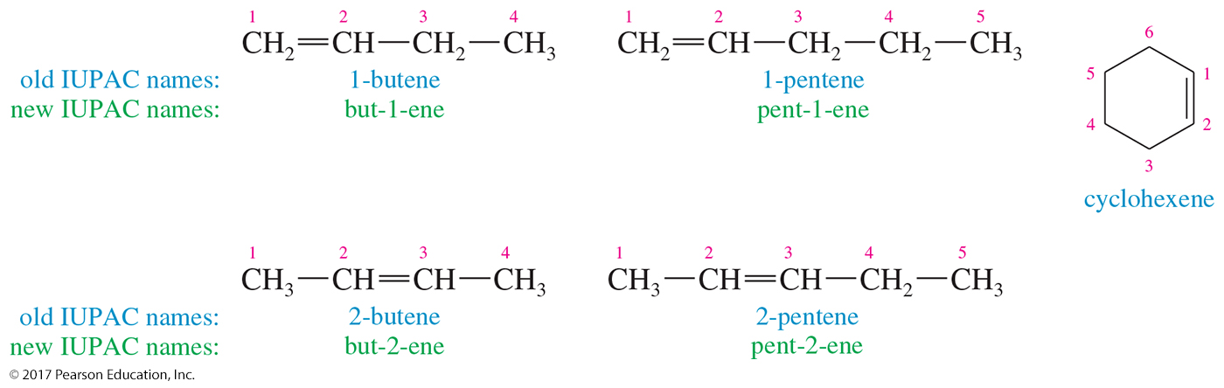
IUPAC and New IUPAC

Slide 17
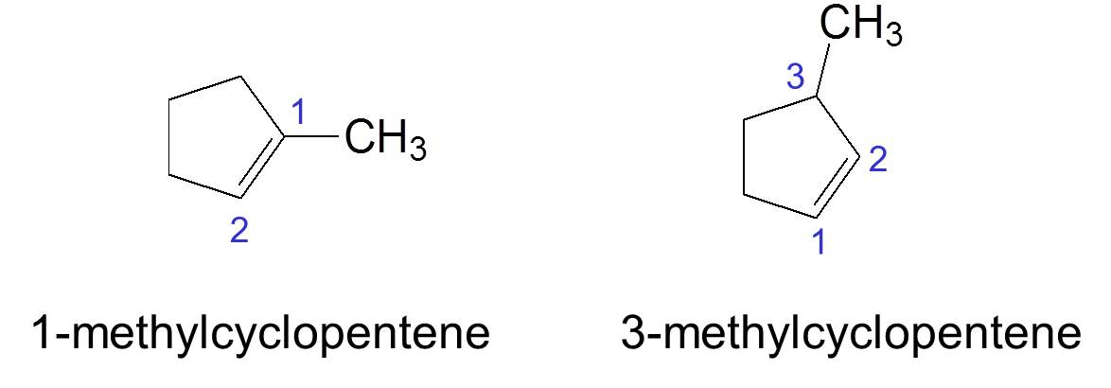
Ring Nomenclature
In a ring, the double bond is assumed to be between carbon 1 and carbon 2.

Slide 18
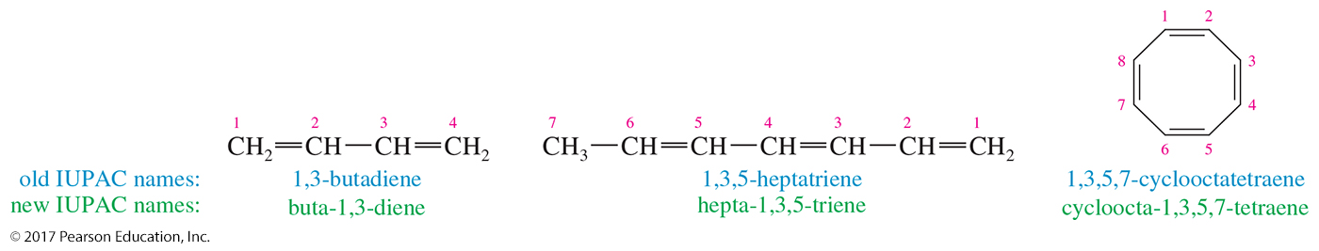
Multiple Double Bonds
Give the double bonds the lowest numbers possible.
Use di-, tri-, or tetra- before the ending -ene to specify how many double bonds are present.

Slide 19
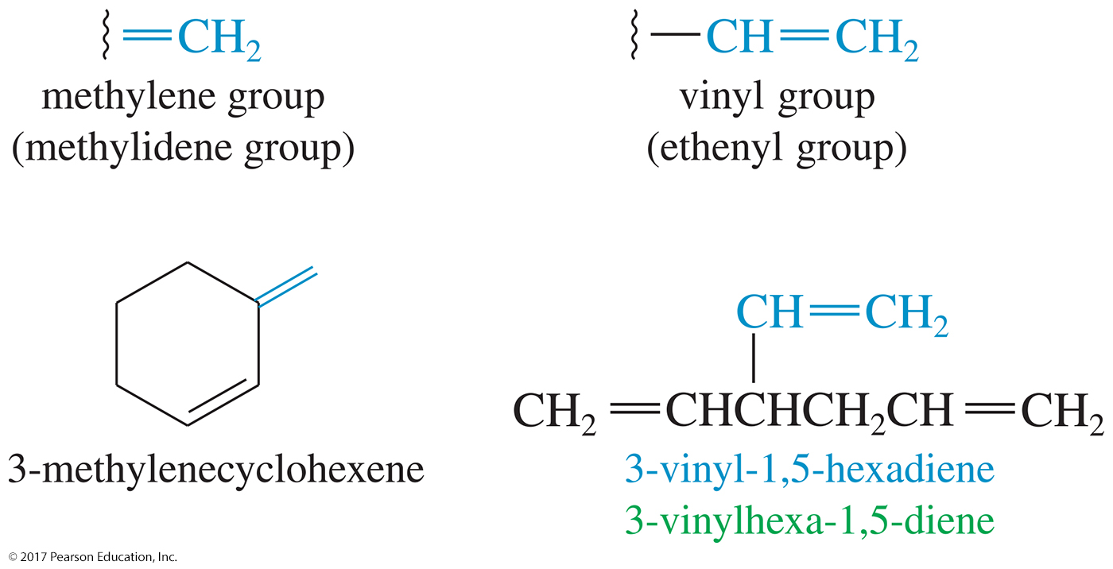
Alkenes As Substitutents

Slide 20
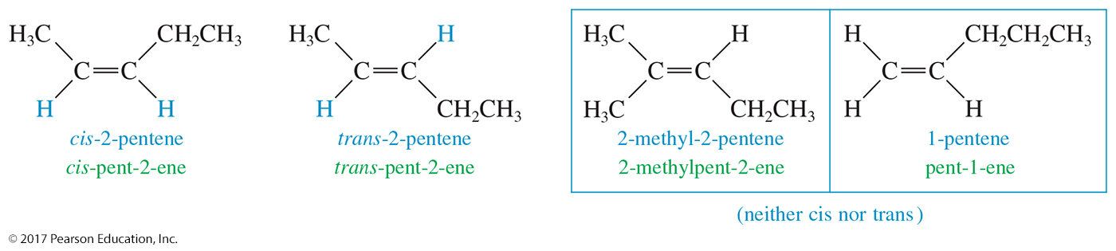
Cis-Trans Isomers
Also called geometric isomerism
If there are similar groups on same side of the double bond, alkene is cis.
If there are similar groups on opposite sides of the double bond, alkene is trans.
Not all alkenes show cis-trans isomerism.

Slide 21
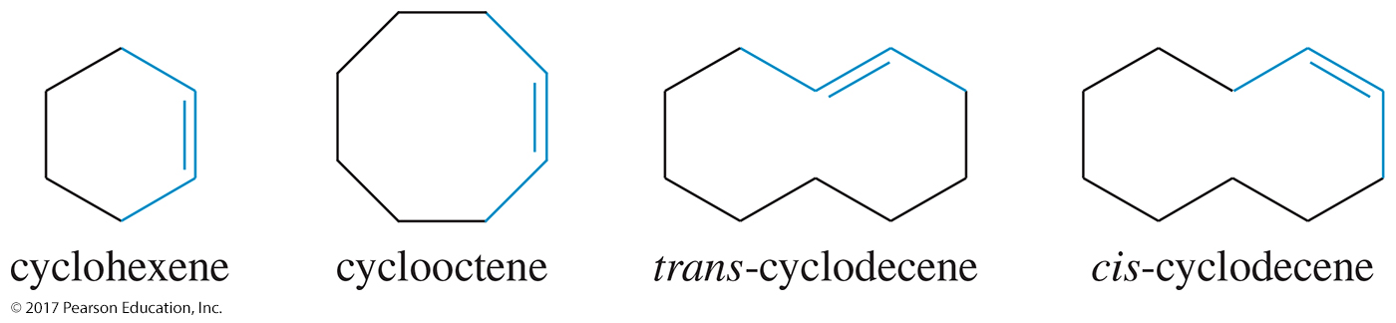
Cyclic Compounds
Trans cycloalkenes are not stable unless the ring has at least eight carbons.
All cycloalkenes are assumed to be cis unless otherwise specifically named trans.

Slide 22
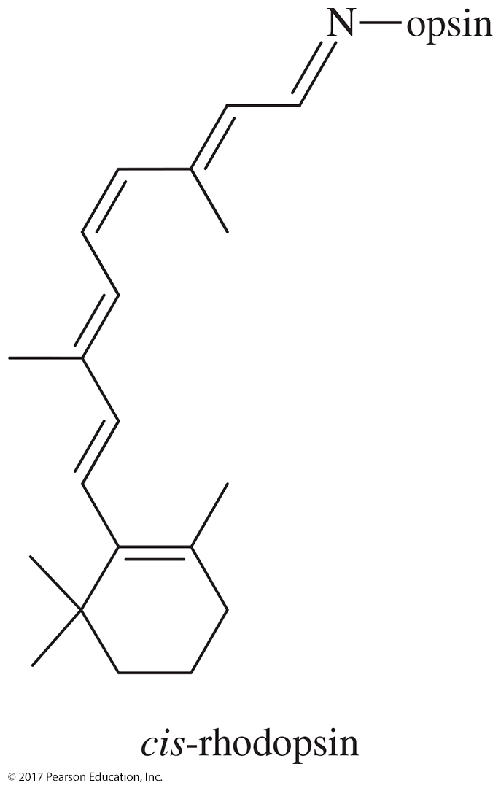
Biochemistry Application

Slide 23
E-Z Nomenclature
Use the Cahn–Ingold–Prelog rules to assign priorities to groups attached to each carbon in the double bond.
If high-priority groups are on the same side, the name is Z (for zusammen).
If high-priority groups are on opposite sides, the name is E (for entgegen).

Slide 24
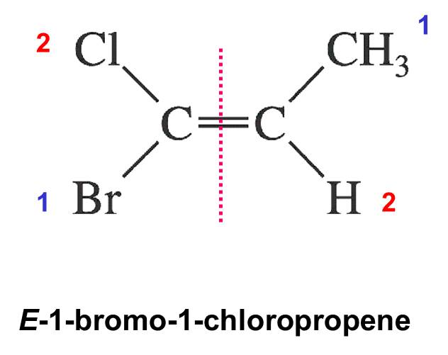
Example
Assign priority to the substituents according to their atomic number (1 is highest priority).
If the highest priority groups are on opposite sides, the isomer is E.
If the highest priority groups are on the same side, the isomer is Z.

Slide 25
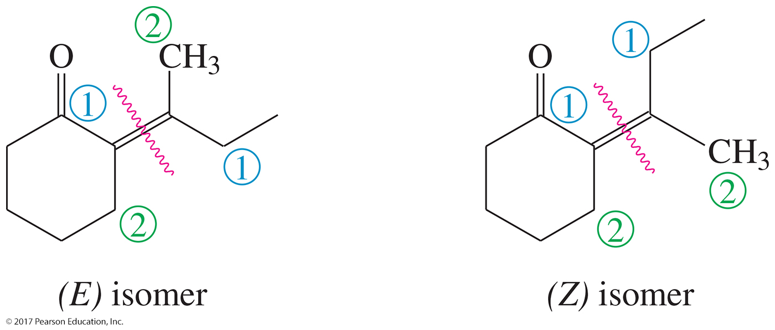
Cyclic Stereoisomers
Double bonds outside the ring can show stereoisomerism.

Slide 26
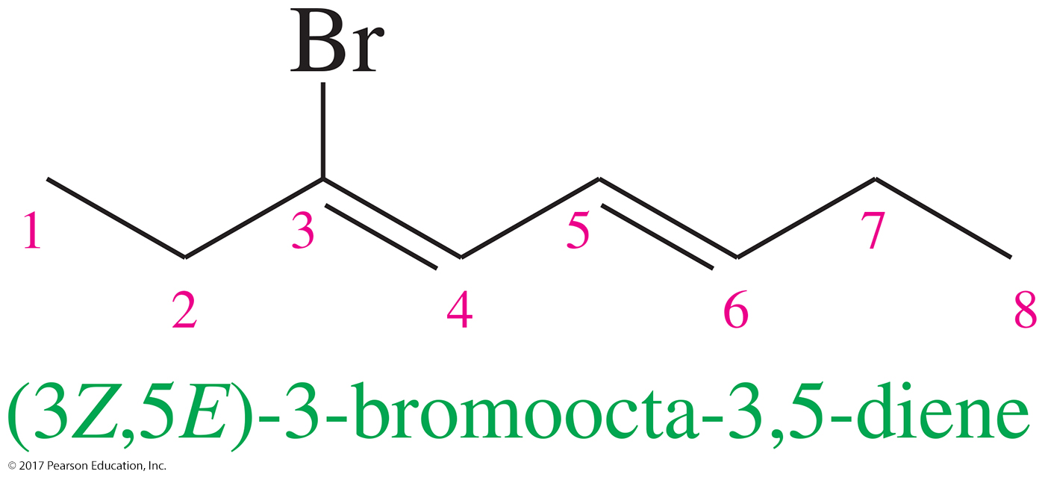
Stereochemistry in Dienes
If there is more than one double bond in the molecule, the stereochemistry of all the double bonds should be specified.

Slide 27
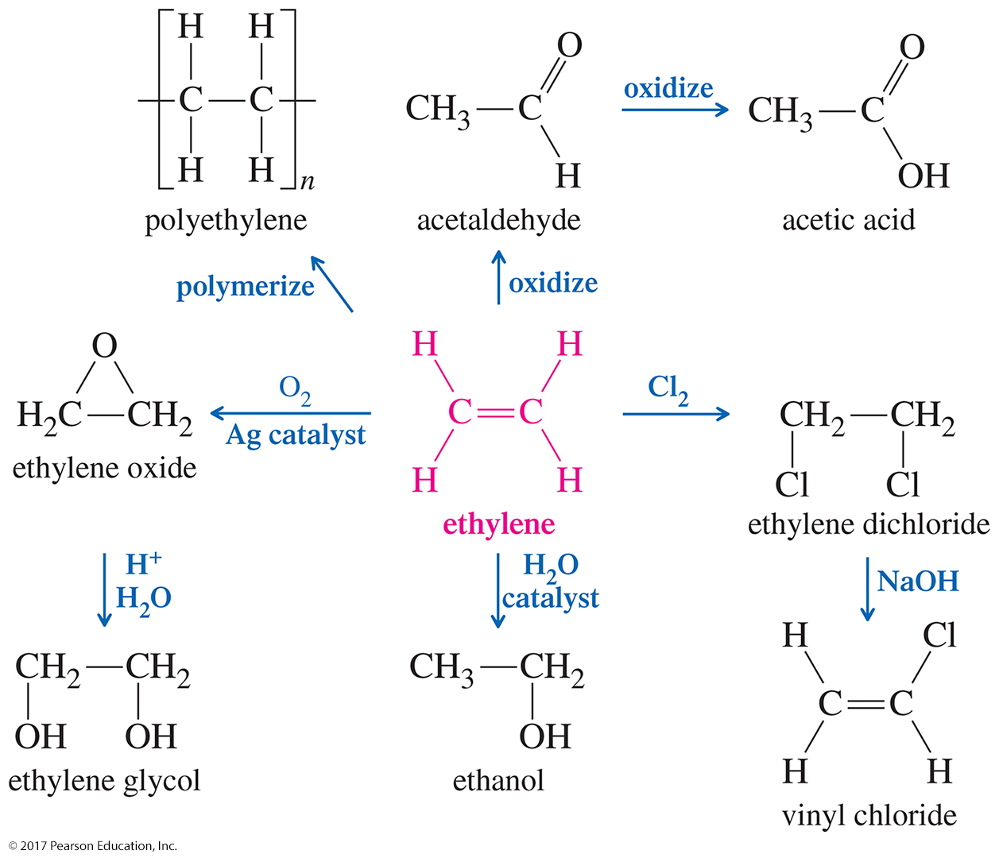
Commercial Uses of Ethylene

Slide 28
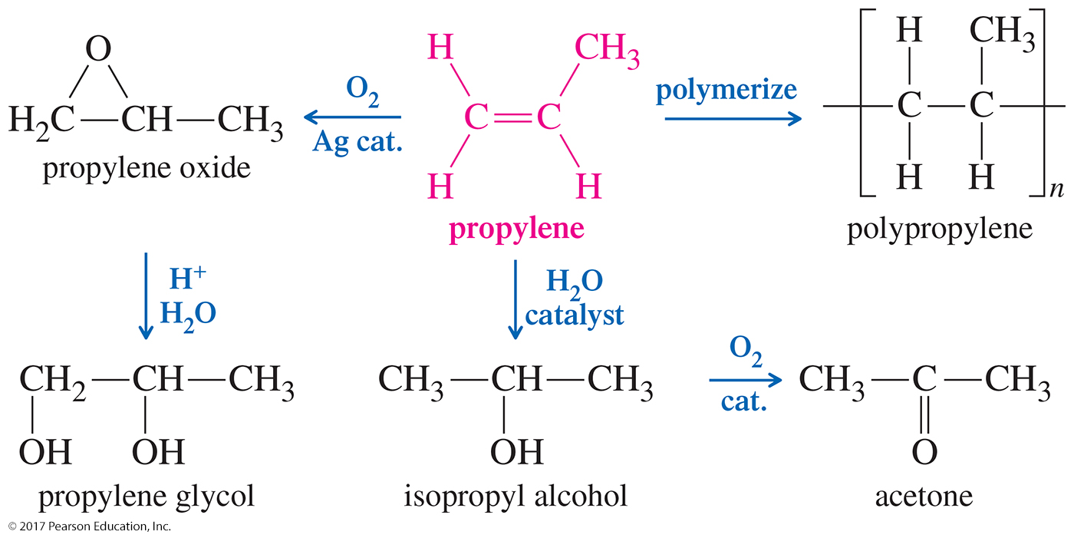
Commercial Uses of Propylene

Slide 29
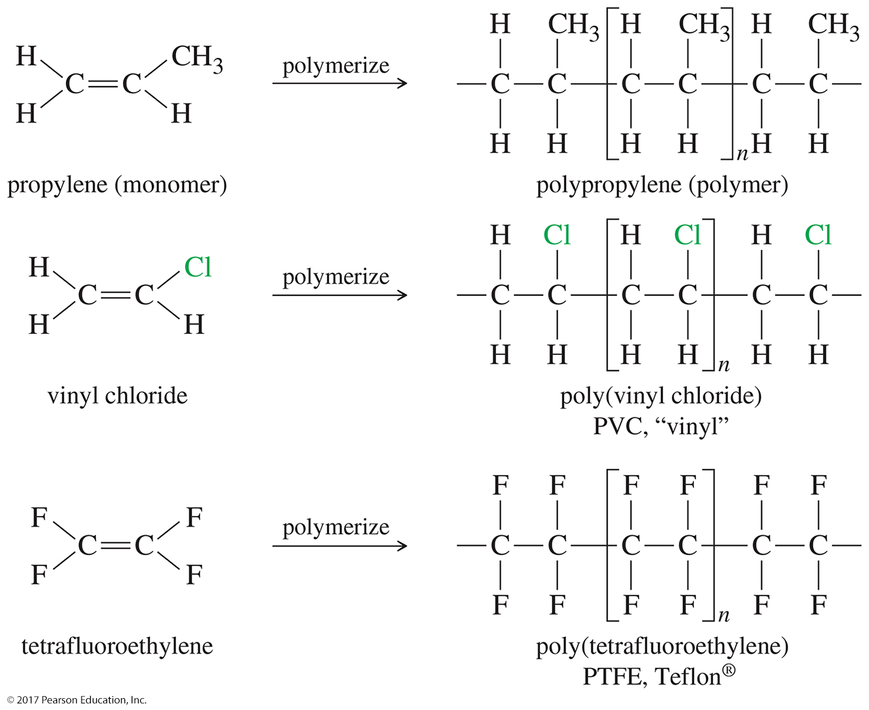
Addition Polymers

Slide 30
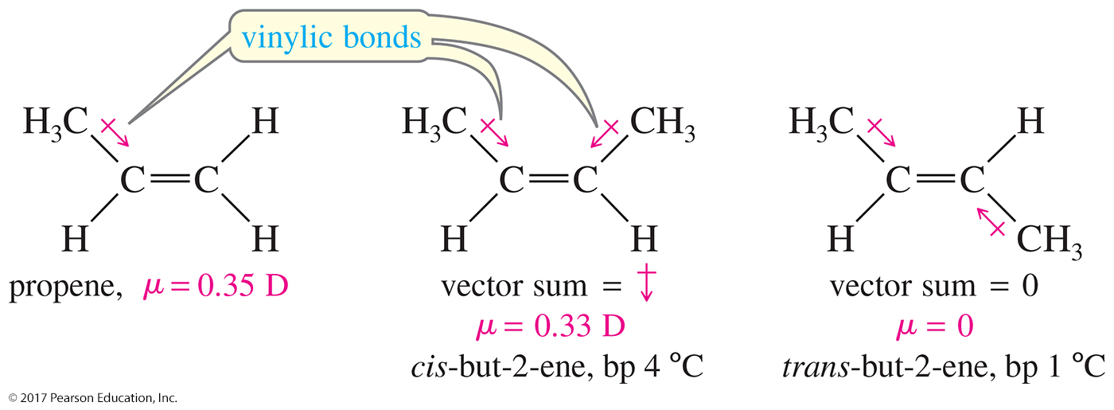
Physical Properties of Alkenes

Slide 31
Polarity and Dipole Moments of Alkenes
Cis alkenes have a greater dipole moment than trans alkenes, so they will be slightly polar.
The boiling point of cis alkenes will be higher than the trans alkenes.

Slide 32
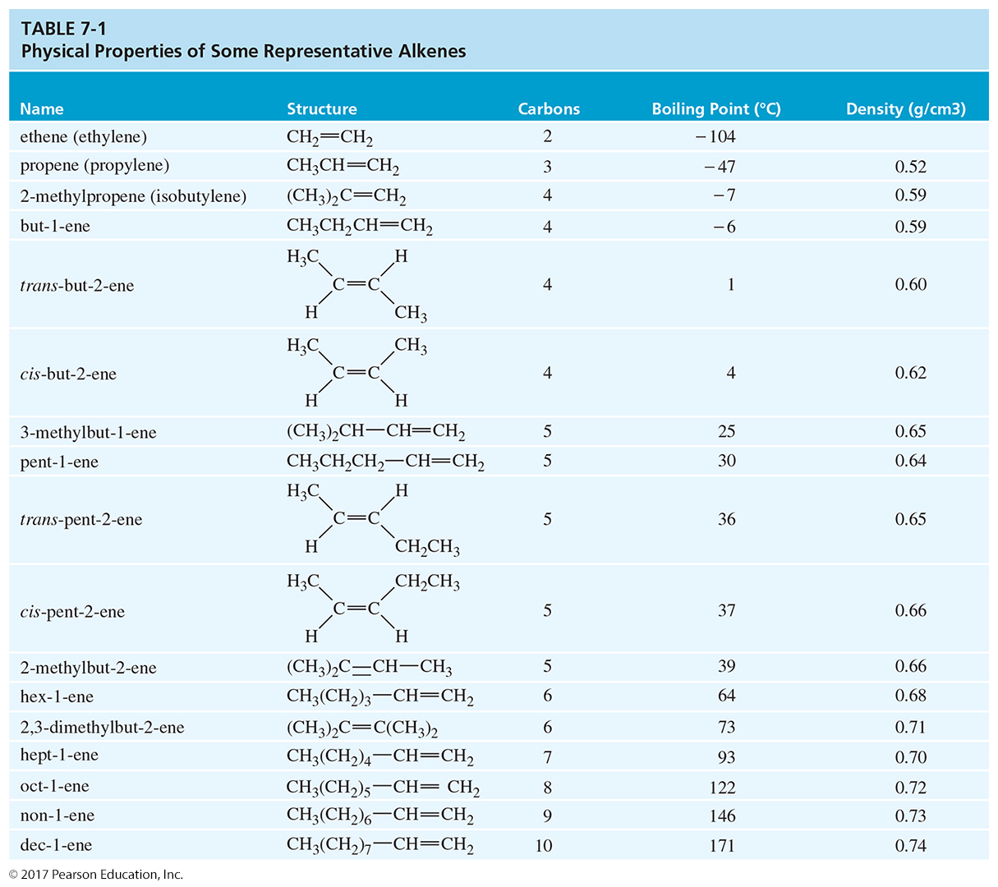

Slide 33
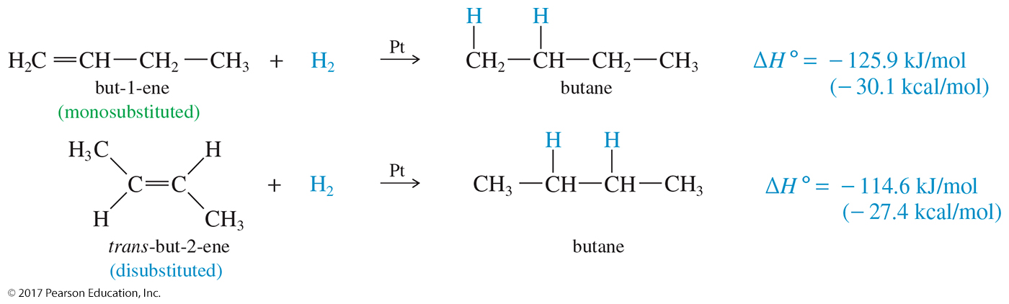
Heat of Hydrogenation
Combustion of an alkene and hydrogenation of an alkene can provide valuable data as to the stability of the double bond.
The more substituted the double bond, the lower its heat of hydrogenation.

Slide 34
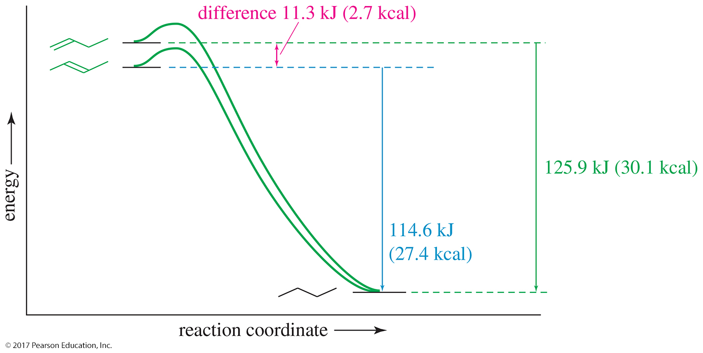
Relative Heats of Hydrogenation
More substituted double bonds are usually more stable.

Slide 35
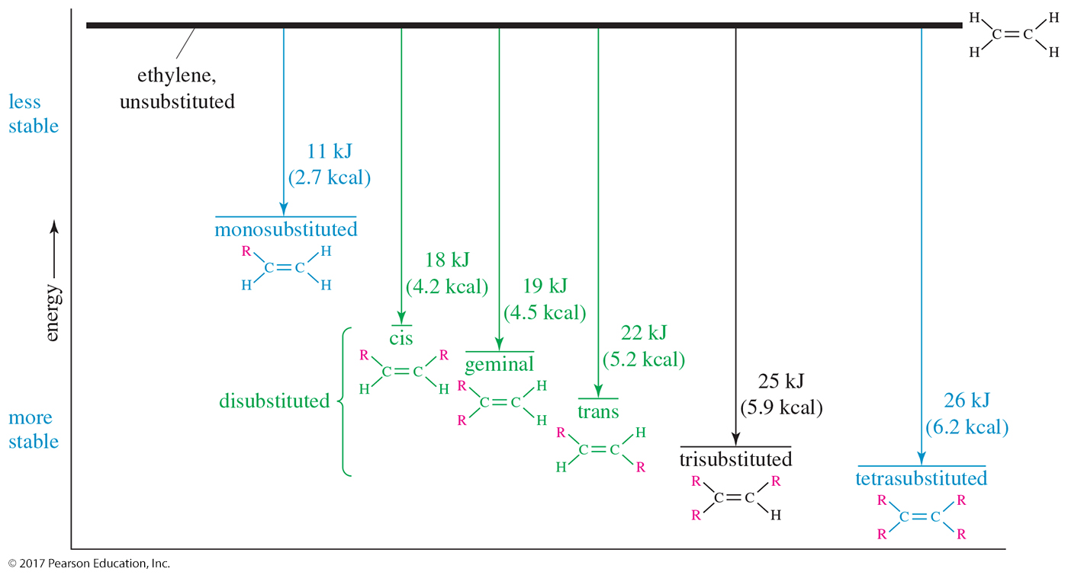
Relative Stabilities

Slide 36
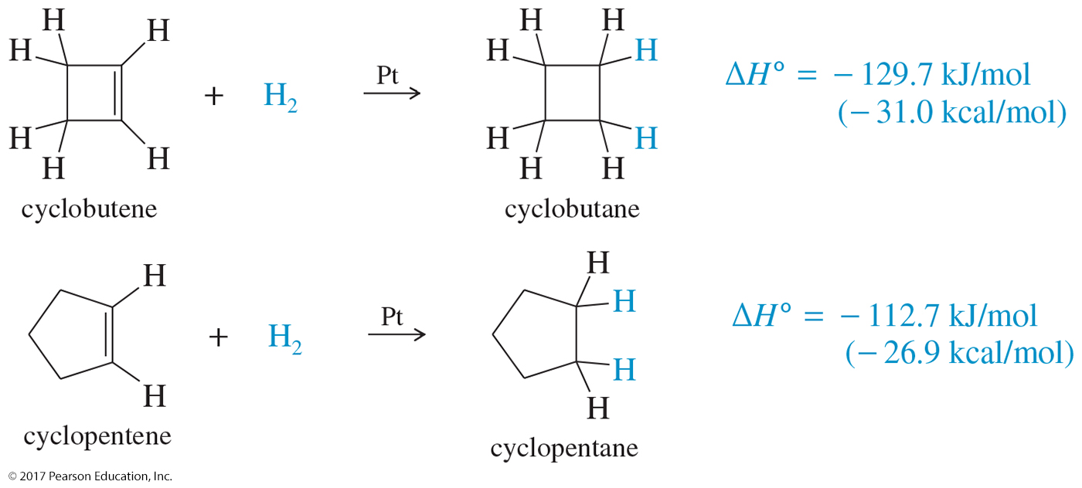
Cycloalkenes
A ring makes a major difference only if there is ring strain, either because of a small ring or because of a trans double bond.
Rings that are five-membered or larger can easily accommodate double bonds, and these cycloalkenes react much like straight-chain alkenes.

Slide 37
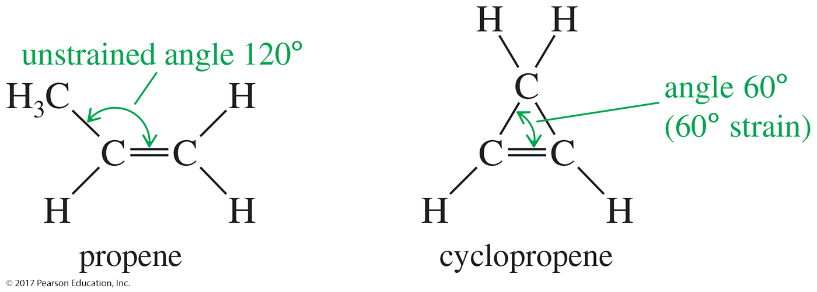
Cyclopropene
Cyclopropene has bond angles of about 60°, compressing the bond angles of the carbon–carbon double bond to half their usual value of 120°.
The double bond in cyclopropene is highly strained.

Slide 38
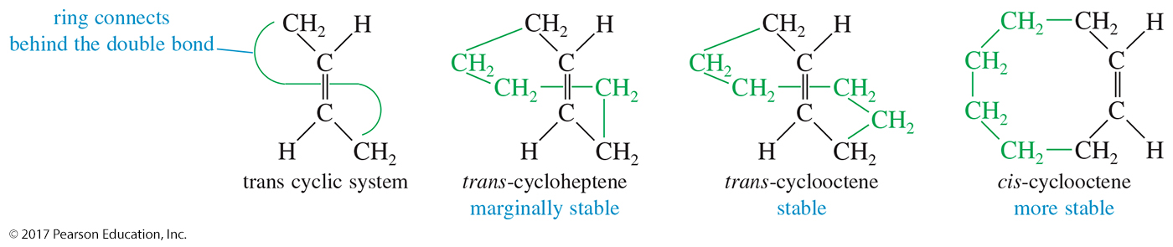
Stability of Cycloalkene
Cis isomer is more stable than trans in small cycloalkenes.
Small rings have additional ring strain.
It must have at least eight carbons to form a stable trans double bond.
For cyclodecene (and larger), the trans double bond is almost as stable as the cis.

Slide 39
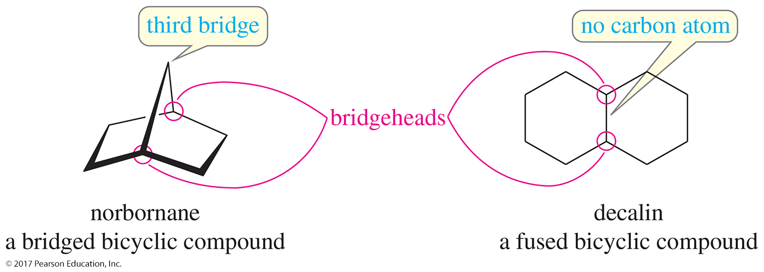
Bredt’s Rule
A bridged, bicyclic compound cannot have a double bond at a bridgehead position unless one of the rings contains at least eight carbon atoms.

Slide 40
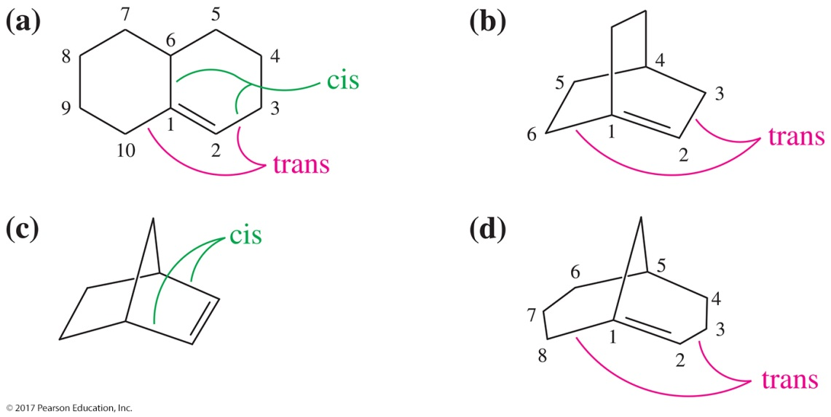
Solved Problem 1
Which of the following alkenes are stable?
Solution
Compound (a) is stable. Although the double bond is at a bridgehead, it is not a bridged bicyclic system. The trans double bond is in a ten-membered ring. Compound (b) is a Bredt’s rule violation and is not stable. The largest ring contains six carbon atoms, and the trans double bond cannot be stable in this bridgehead position.
Compound (c) (norbornene) is stable. The (cis) double bond is not at a bridgehead carbon. Compound (d) is stable. Although the double bond is at the bridgehead of a bridged bicyclic system, there is an eight-membered ring to accommodate the trans double bond.

Slide 41
Physical Properties of Alkenes
Low boiling points, increasing with mass
Branched alkenes have lower boiling points.
Less dense than water
Slightly polar
Pi bond is polarizable, so instantaneous dipole–dipole interactions occur.
Alkyl groups are electron-donating toward the pi bond, so they may have a small dipole moment.

Slide 42
Alkene Synthesis Overview
E2 dehydrohalogenation (–HX)
E1 dehydrohalogenation (–HX)
Dehalogenation of vicinal dibromides (–X₂)
Dehydration of alcohols (–H₂O)

Slide 43
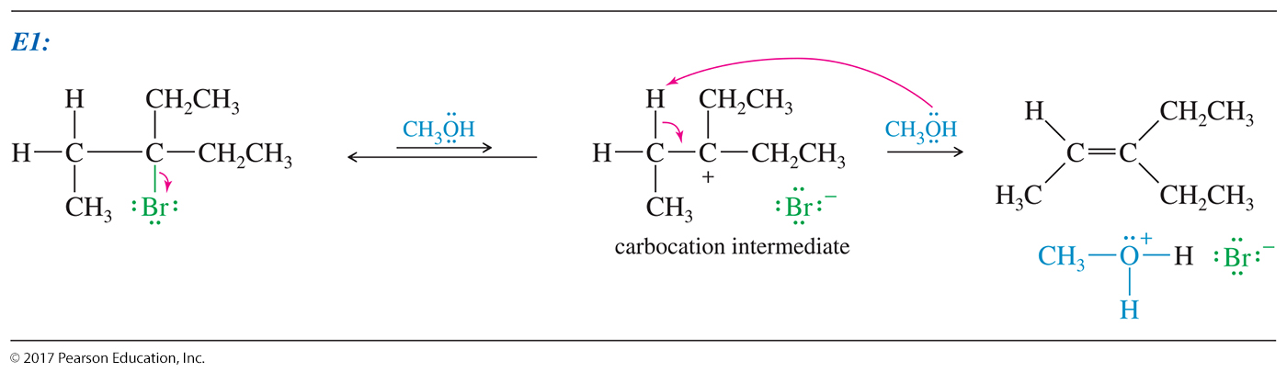
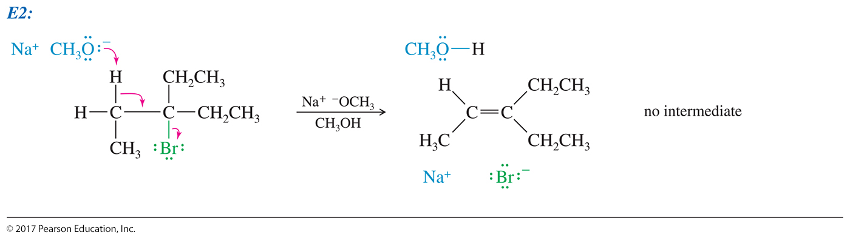
Elimination Reactions
Elimination reactions produce double bonds.
Also called dehydrohalogenation (–HX)

Slide 44
The E1 Reaction
Unimolecular elimination
Two groups are lost: a hydrogen and the halide.
Nucleophile acts as base.
The E1 and S_{N}1 reactions have the same conditions, so a mixture of products will be obtained.

Slide 45
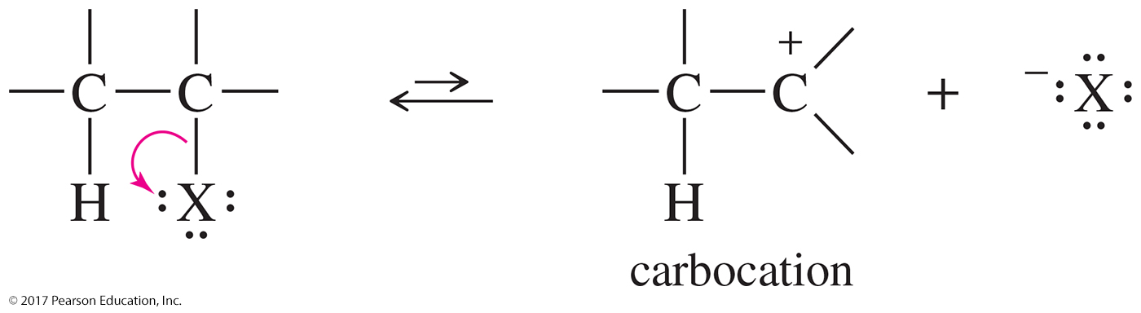
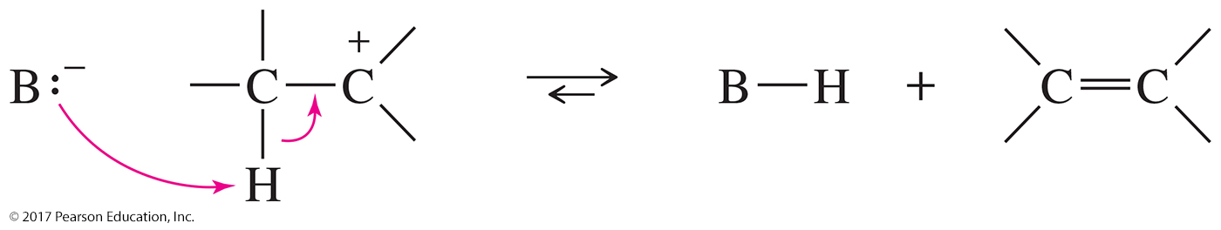
E1 Mechanism
Step 1: Ionization to form a carbocation
Step 2: Solvent abstracts a proton to form an alkene.

Slide 46
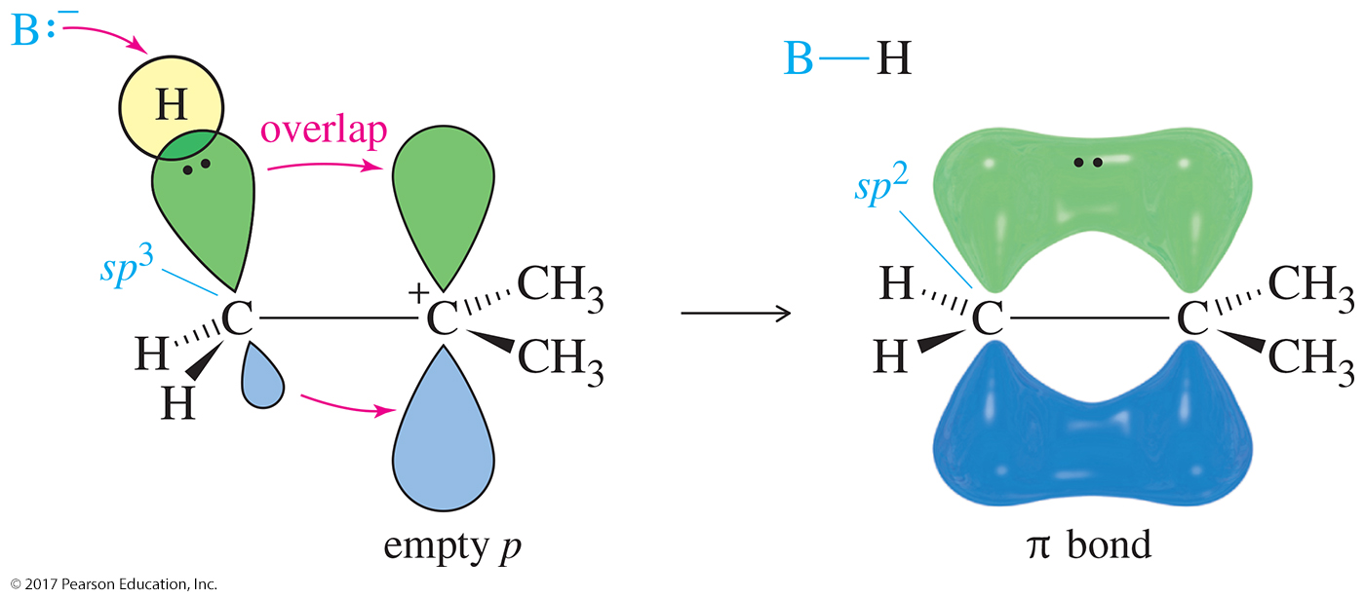
A Closer Look

Slide 47
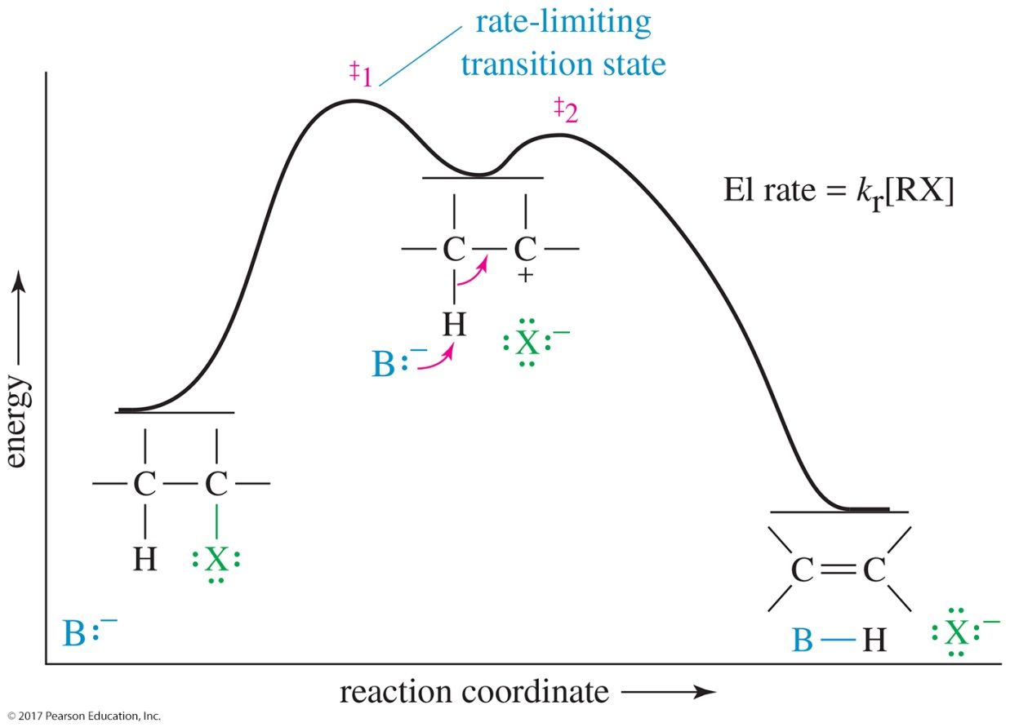
E1 Energy Diagram
The E1 and the S_{N}1 reactions have the same first step: Carbocation formation is the rate-determining step for both mechanisms.

Slide 48
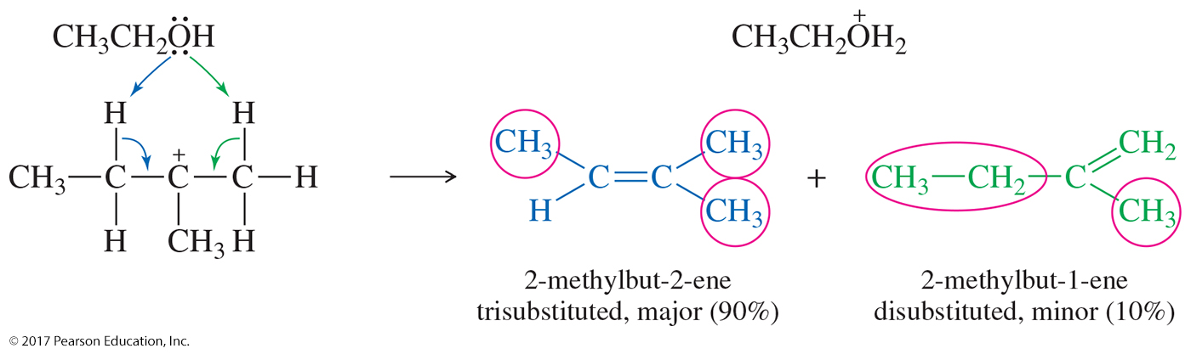
Zaitsev’s Rule
If more than one elimination product is possible, the most-substituted alkene is the major product (most stable).
major product
(trisubstituted)

Slide 49
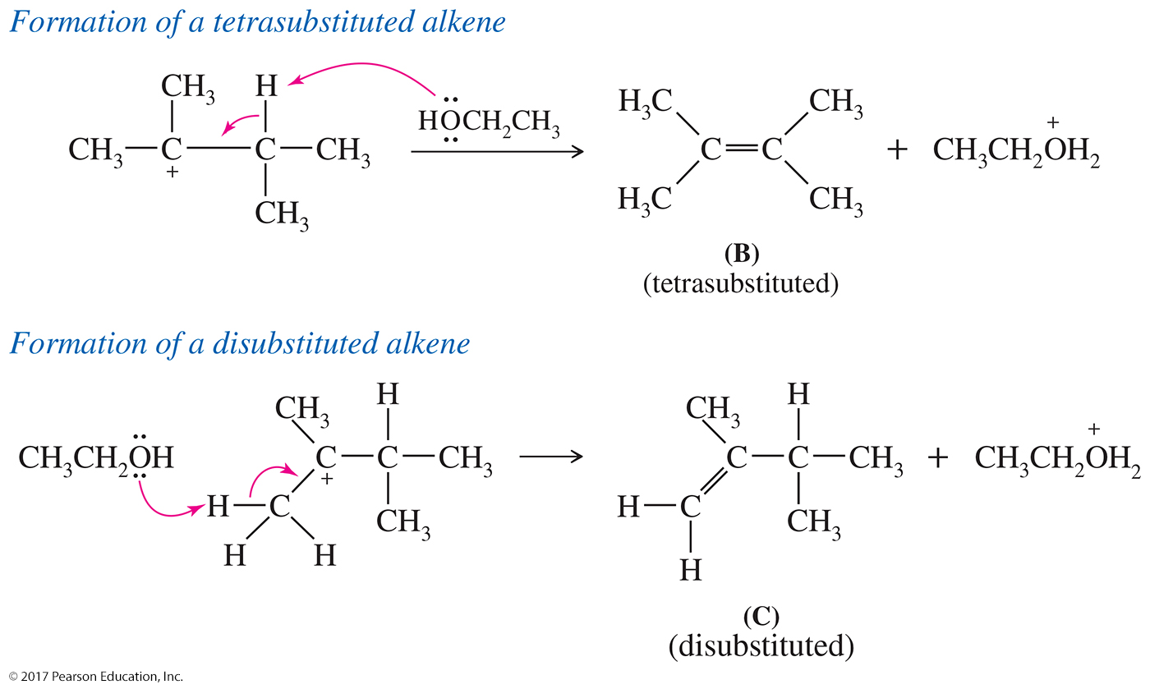
Alkene Stability

Slide 50
The E2 Reaction
Elimination, bimolecular
Requires a strong base
This is a concerted reaction: The proton is abstracted, the double bond forms, and the leaving group leaves, all in one step.

Slide 51
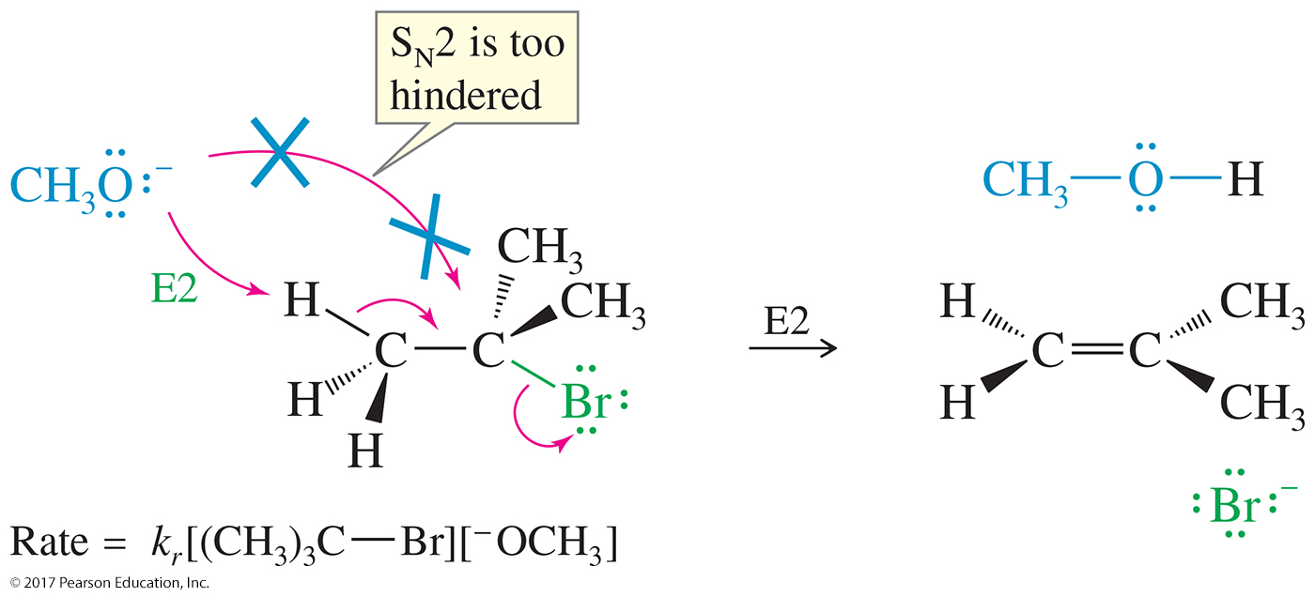
The E2 Reaction

Slide 52
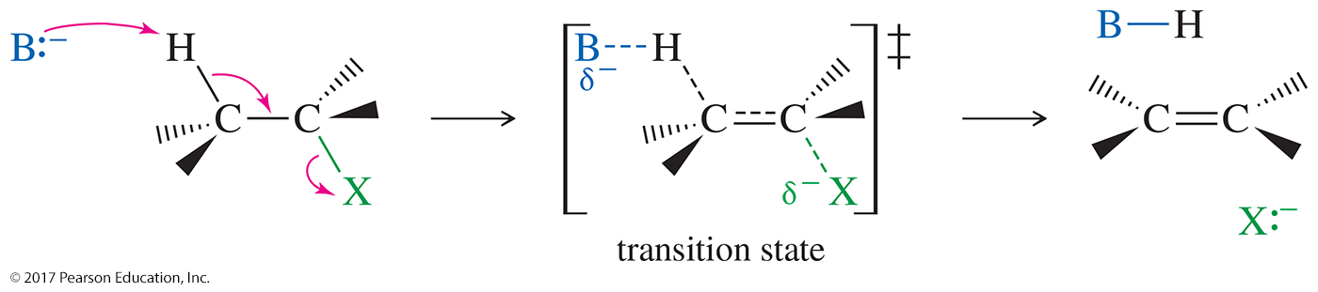
The E2 Mechanism
Order of reactivity for alkyl halides 3° > 2° > 1°
A mixture may form, but the Zaitsev product predominates.

Slide 53
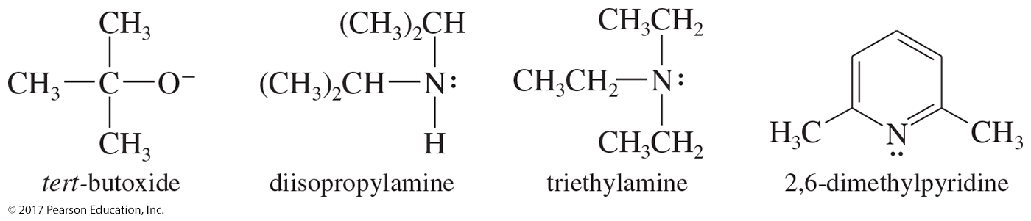
Bulky Bases in E2 Eliminations; Hofmann Orientation
If the substrate in an E2 elimination is prone to substitution, we can minimize the amount of substitution by using a bulky base.
Bulky bases can accomplish dehydrohalogenations that do not follow the Zaitsev rule. They form the Hofmann product.

Slide 54
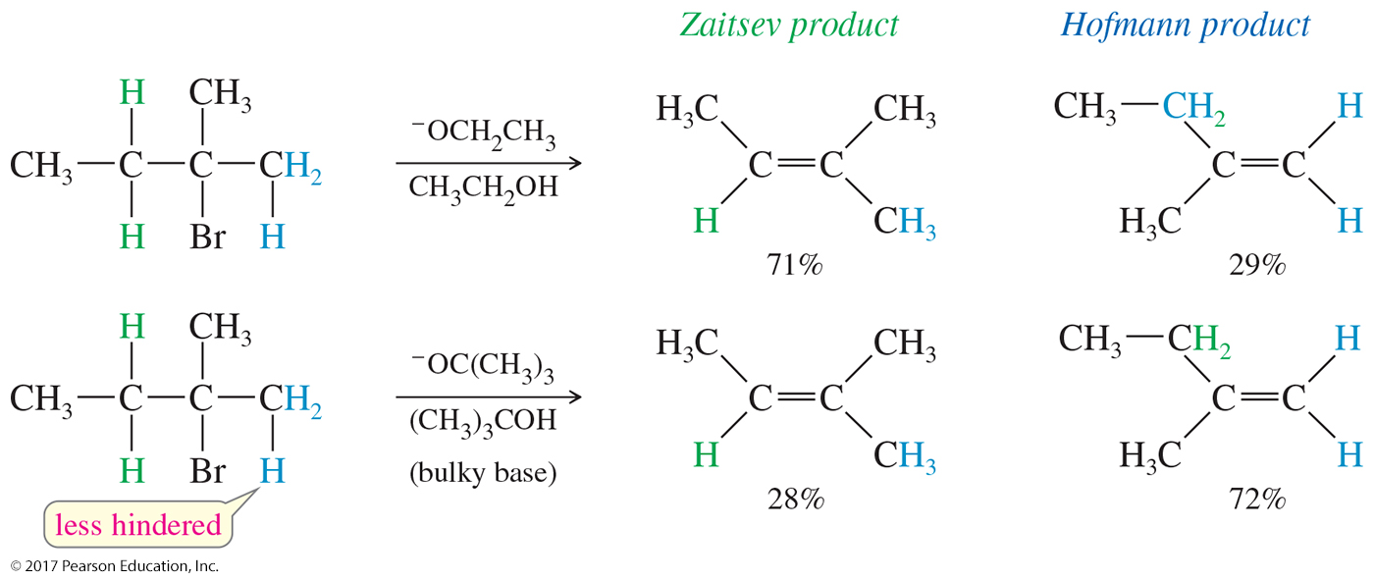
Zaitsev and Hofmann Products

Slide 55
E2 Stereochemistry
The halide and the proton to be abstracted must be anti-coplanar (θ = 180º) to each other for the elimination to occur.
The orbitals of the hydrogen atom and the halide must be aligned so they can begin to form a pi bond in the transition state.
The anti-coplanar arrangement minimizes any steric hindrance between the base and the leaving group.

Slide 56
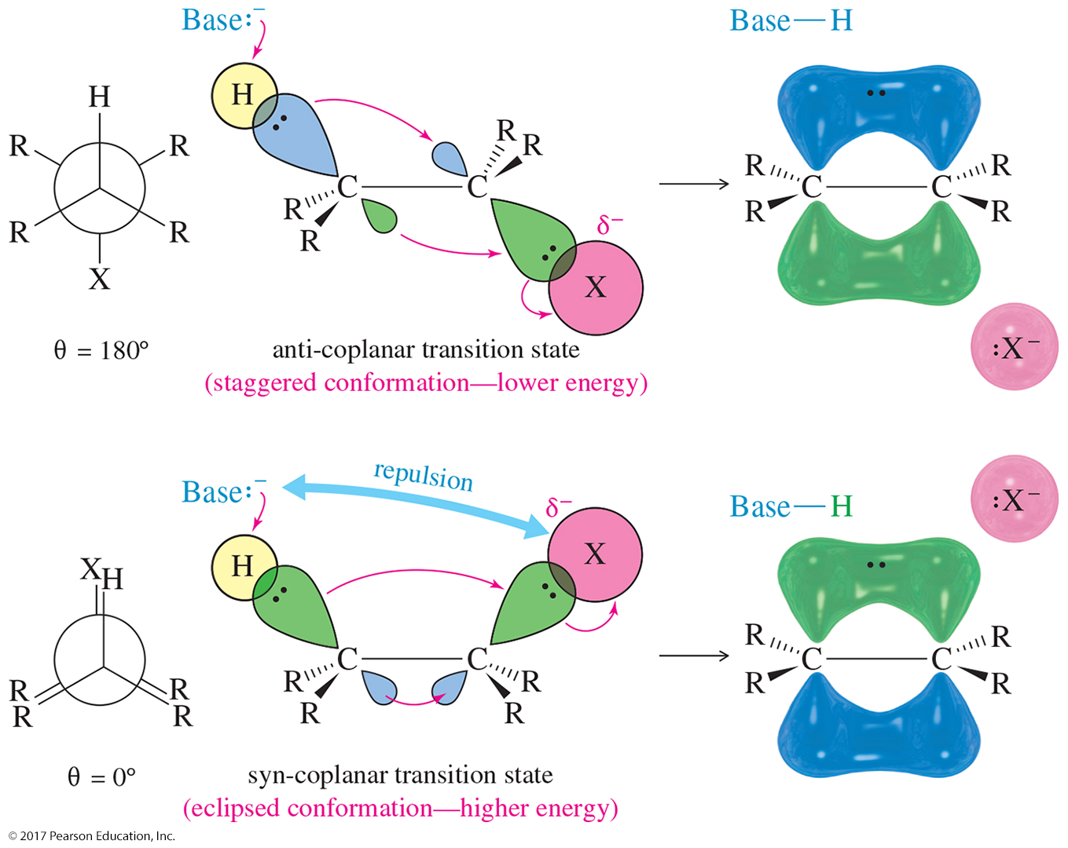
E2 Stereochemistry

Slide 57
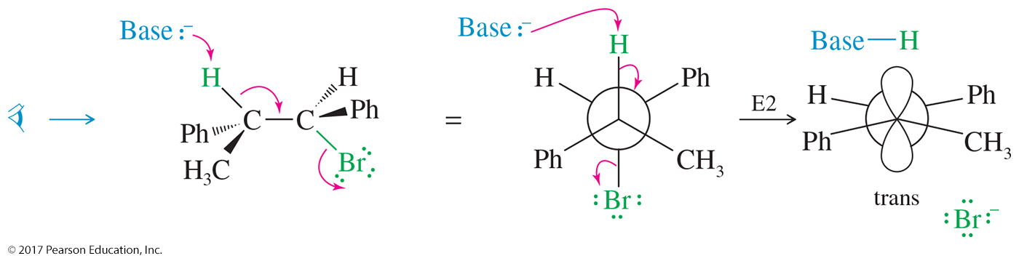
Stereochemistry of E2 Elimination
Most E2 reactions go through an anti-coplanar transition state.
This geometry is most apparent if we view the reaction with the alkyl halide in a Newman projection.

Slide 58
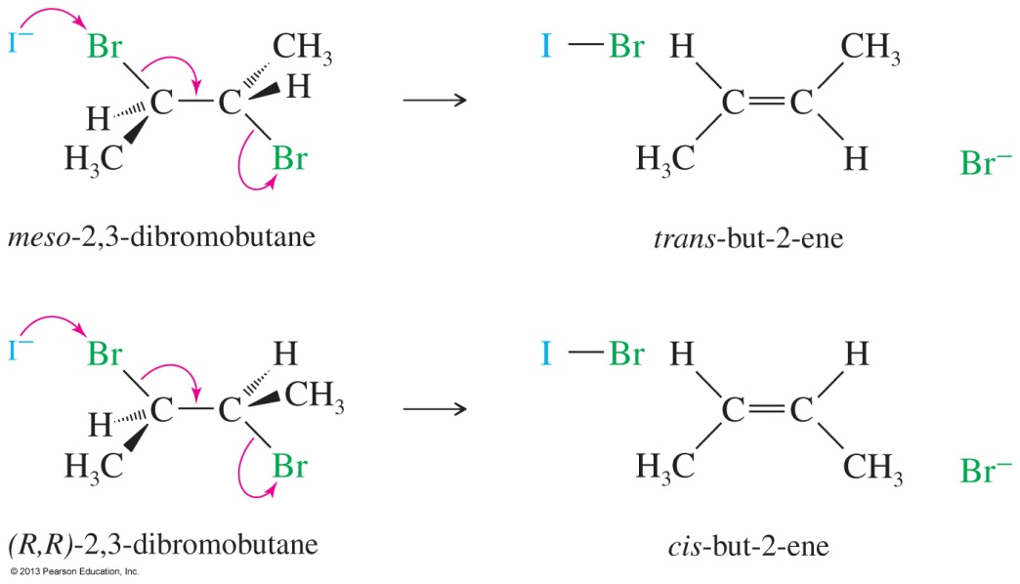
Solved Problem 2
Show that the dehalogenation of 2,3-dibromobutane by iodide ion is stereospecific by showing that the two diastereomers of the starting material give different diastereomers of the product.
Solution
Rotating meso-2,3-dibromobutane into a conformation where the bromine atoms are anti and coplanar, we find that the product will be trans-2-butene. A similar conformation of either enantiomer of the (±) diastereomer shows that the product will be cis-2-butene. (Hint: Your models will be helpful.)

Slide 59
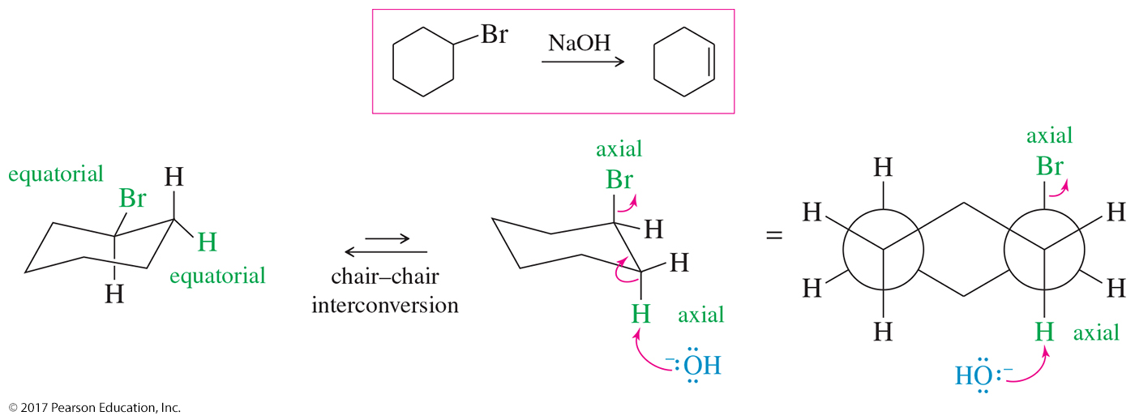
E2 Reactions on Cyclohexanes
An anti-coplanar conformation (180°) can only be achieved when both the hydrogen and the halogen occupy axial positions.
The chair must flip to the conformation with the axial halide in order for the elimination to take place.

Slide 60
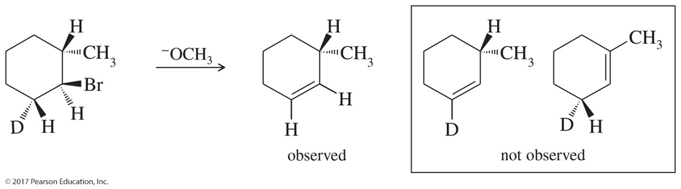
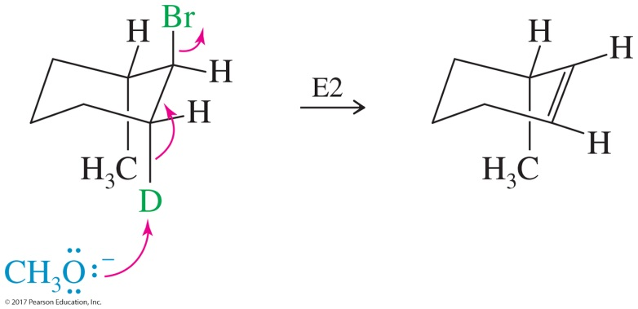
Solved Problem 3
Explain why the following deuterated 1-bromo-2-methylcyclohexane undergoes dehydrohalogenation by the E2 mechanism, to give only the indicated product. Two other alkenes are not observed.
Solution
In an E2 elimination, the hydrogen atom and the leaving group must have a trans-diaxial relationship. In this compound, only one hydrogen atom—the deuterium—is trans to the bromine atom. When the bromine atom is axial, the adjacent deuterium is also axial, providing a trans-diaxial arrangement.

Slide 61
Substitution or Elimination?
The strength of the nucleophile determines the order: Strong nucleophiles or bases promote bimolecular reactions.
Primary halides usually undergo S_{N}2.
Tertiary halides are a mixture of S_{N}1, E1, or E2. They cannot undergo S_{N}2.
High temperature favors elimination.
Bulky bases favor elimination.

Slide 62
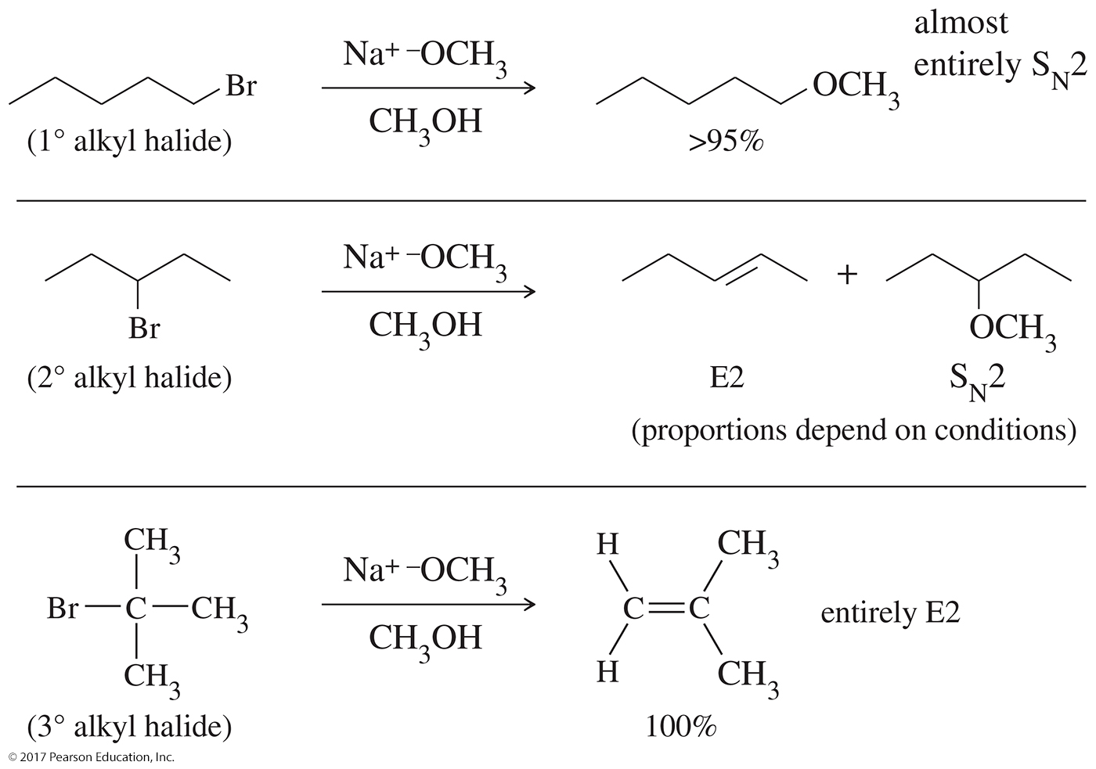

Slide 63

Secondary Alkyl Halides
Secondary alkyl halides are more challenging:
Strong nucleophiles will promote S_{N}2/E2.
Weak nucleophiles promote S_{N}1/E1.
Strong nucleophiles with limited basicity favor S_{N}2. Bromide and iodide are good examples of these.

Slide 64


Solved Problem 4
Predict the mechanisms and products of the following reaction.
Solution

Slide 65


Solved Problem 5
Predict the mechanisms and products of the following reaction.
Solution

Slide 66


E1 and S_{N}1 Mechanisms

Slide 67

Dehydration of Alcohols
Use concentrated H₂SO₄ or H₃PO₄ and remove low-boiling alkene as it forms to shift the equilibrium and increase the yield of the reaction.
E1 mechanism
Rearrangements are common.
The reaction obeys Zaitsev’s rule.

Slide 68


Dehydration Mechanism: E1
Step 1: Protonation of the hydroxyl group (fast equilibrium)
Step 2: Ionization to a carbocation (slow; rate limiting)

Slide 69

Dehydration Mechanism: Step 3
Step 3: Deprotonation to give the alkene (fast)

Slide 70



Solved Problem 6
Propose a mechanism for the sulfuric acid-catalyzed dehydration of t-butyl alcohol
Solution
The first step is protonation of the hydroxyl group, which converts it to a good leaving group.
The second step is ionization of the protonated alcohol to give a carbocation.
Abstraction of a proton completes the mechanism.

Slide 71

Catalytic Cracking of Alkanes
A long-chain alkane is heated with a catalyst to produce an alkene and shorter alkane.
Complex mixtures are produced.

Slide 72

Dehydrogenation of Alkanes
Dehydrogenation is the removal of H₂ from a molecule, forming an alkene (the reverse of hydrogenation).
This reaction has an unfavorable enthalpy change but a favorable entropy change.

